Slide 1
The Quiz

Slide 2
Montana Quinn, the chief of police of the city of Rockne, Ohio has announced her resignation from the force.

Slide 3

Rockne’s Mayor, Michael Bergbloom, has asked the City Council to consider whether Rockne should continue to maintain a police force, or whether it should delegate that function to…

Slide 4

“Special Ops,” a private security firm.

Slide 5

Council appoints a task force of leading citizens to advise it on the question of disbanding the police force.

Slide 6

At its next meeting, City Council President Frances Baker, announces that she intends to discuss the issue in executive session. Baker states that the executive session is appropriate because elimination of the police force would result in layoffs, and that makes the discussion a “personnel matter.”

Slide 7

Baker also states that since a decision to eliminate the force will “almost certainly result in a lawsuit,” she has asked the City Attorney Bob Faust, to attend the executive session. Baker states that the presence of Faust also necessitates the executive session.

Slide 8

Although Rockne’s charter requires that all proceedings of council be conducted in public, the Rockne council routinely convenes executive sessions, pursuant to the Ohio Open Meetings Act.

Slide 9

In the executive session, the counsel votes 4-3 against disbanding the police force. The counsel also decides to retain Hide The Ball Recruiters, a private executive search firm, to coordinate the search for a new police chief.

Slide 10

The deciding vote was cast by Earl Hayes, who participated by speaker phone from his vacation home in the Upper Peninsula of Michigan.

Slide 11

Hide The Ball Recruiters manages all aspects of the search process. It coordinates the advertising, receives candidate resumes and schedules interviews.

Slide 12

In meetings with the City Manager, Ted Malloy held twice weekly, it provides copies of resumes and summarizes progress. Hide The Ball takes the resumes back at the end of each meeting, and the City Manager does not retain copies.

Slide 13
Over the course of the process, several council members receive letters from constituents expressing their thoughts on suitable candidates. None of the council members share these letters with Hide The Ball.

Slide 14
As the process continues, Terry Theisman, the Police Chief of Devine, Ohio, emerges as a leading candidate.

Slide 15

As part of the Hide The Ball process, Theisman submits to a psychological evaluation conducted by Dr. Anne Arbor, a Hide The Ball Staff Psychiatrist.

Slide 16
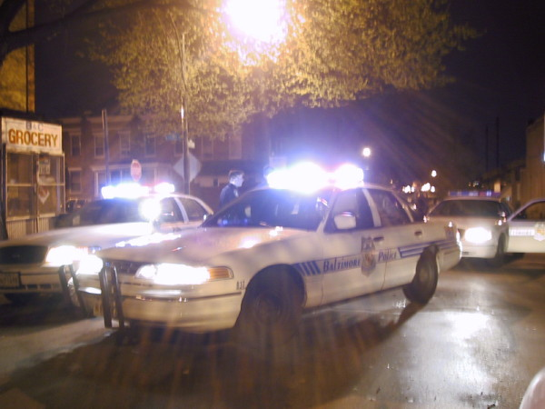
Rumors begin to surface that Theisman has a troubled personal life. According to one story, several months earlier, Theisman’s wife had placed a 911 call complaining that Theisman was assaulting her at their home. Apparently, Devine police completed an incident report responding to the call, and the case remains under investigation.

Slide 17

Theisman is also rumored to be involved in an extramarital affair with a younger woman. According to the gossip, police officers in Devine routinely exchange e-mails ridiculing Theisman’s relationship with the young woman. There is also a story that Theisman had destroyed 2 months worth of daily duty logs to hide evidence of his whereabouts.

Slide 18

Hide The Ball prepares a “draft” recommendation that discusses all of the above information. Malloy, the City Manager, recommends that Hide The Ball rework the recommendation and remove the negative information before it submits the report to council.

Slide 19
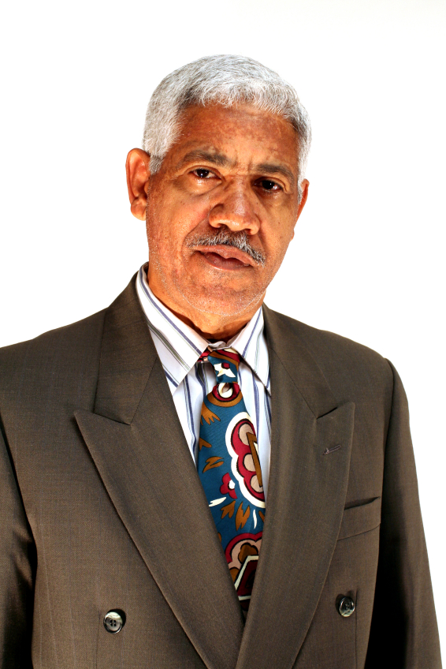
A reporter for the Rockne Tribune, “Digger” Brey, visits the Devine Police Department and orally requests a file photo of Theisman, the 911 tape of the domestic violence call, the incident report, the investigation file, all e-mails concerning Theisman’s relationship, and a copy of any concealed carry permit issued to Theisman.

Slide 20

Lloyd Schembechler, the Devine records clerk, tells Brey that he will not release any records unless Brey submits the request in writing, provides identification, and states the intended use for the records. Brey requests a copy of the department’s public records policy, which Schembechler refuses to provide.

Slide 21
Earlier that week, Brey had made a written request to the City of Rockne for all resumes received by Hide The Ball, all correspondence relating to the police chief search, and all Hide The Ball records concerning the search.

Slide 22

Q1
Question 1
Did Rockne City Council properly convene an executive session?
Yes
NO
Maybe

Slide 23

Q1C
Correct
Answer: No
The decision to convene an executive session requires a roll call vote.

Slide 24
Question 2
By chance, 4 of the 7 Rockne Council members meet at a high school football game and discuss the police force matter, does this meeting violate the Open Meeting Act?
Yes
No
Maybe

Slide 25
Q2C
Correct
Answer: No
The Open Meeting Act only covers “prearranged” meetings.

Slide 26
Q3
Question 3
Because the Rockne City Council was discussing personnel matters, it was entitled to conduct its discussion regarding disbanding the police force in executive session.
True
False

Slide 27
Q3C
Correct
Answer: False
The personnel matters must concern action involving a specific employee.

Slide 28

Q3
Question 4
Because council met with its attorney concerning a potential lawsuit those deliberations were properly conducted in executive session.
True
False

Slide 29
Q3C
Correct
Answer: False
Conferences with counsel must concern pending or imminent court action.

Slide 30
Question 5
Could Rockne City Council conduct an interview of Theisman in executive session?
Yes
No
Maybe

Slide 31
Q4C
Correct
Answer: Yes
An interview constitutes a specific personnel matter.

Slide 32
Question 6
The Ohio Open Meeting Act permits Rockne City Council to meet in executive session, despite the charter provision.
True
False

Slide 33
Q6C
Correct
Answer: False
The charter provision requiring all proceedings be open to the public supersedes the executive session provisions of the Ohio Open Meetings Act.

Slide 34

Question 7
Is the private citizen task force a public body for purposes of the Open Meeting Act?
Yes
No
Maybe

Slide 35
Q7C
Correct
Answer: Yes
An advisory committee appointed by a public body is a public body.

Slide 36

Question 8
Is the decision to retain Hide The Ball Recruiters subject to a viable challenge under the Open Meetings Act?
Yes
No
Maybe

Slide 37
Q8C
Correct
Answer: Yes
A public body may not vote in executive session. In addition, actions resulting from an invalid executive session are subject to invalidation.

Slide 38
Question 9
So long as absent council member Hayes can hear and be heard, he is entitled to attend the meeting via speaker phone.
True
False

Slide 39
Q9C
Correct
Answer: False
Members of a public body must be physically present at proceedings.

Slide 40
Question 10
Are the resumes of unsuccessful candidates for the police chief position public records?
Yes
No
Maybe

Slide 41
Q10C
Correct
Answer: Yes
Resumes of all candidates for public positions are public records.

Slide 42
Question 11
Does the fact that the resumes were received and maintained by Hide The Ball Recruiters, a private entity, remove those records from the coverage of the Public Records Act?
Yes
No
Maybe

Slide 43
Q11C
Correct
Answer: Maybe
A private entity’s records may be subject to the Public Records Act if it is the “Functional Equivalent” of the public body.

Slide 44
Question 12
Given that the definition of public records includes records “received” by a public body, the constituent letters received by Rockne Council members are public records, correct?
Yes
No
Maybe

Slide 45
Q13C
Correct
Answer: Maybe
Records are “public” only to the extent they document the organization, functions, policies, decisions, procedures, operations or other activities of the public office. Given that no council members forwarded the constituent letters to Hide The Ball, a strong argument can be made that the letters are not public records.

Slide 46
Question 13
The federal HIPAA statute makes Theisman’s psychological evaluation confidential, and therefore exempt under the Ohio Public Records Act.
True
False

Slide 47
Q14C
Correct
Answer: False
The psychological evaluation is not subject to the “medical record” exemption to the Public Records Act because the record was not created in the “course of treatment.” Because the Ohio Public Records Act requires production, HIPAA does not prohibit it.

Slide 48

Question 14
Is Digger Brey entitled to production of the file photo of Officer Theisman?
Yes
No
Maybe

Slide 49
Q15C
Correct
Answer: NO
Police photos are exempt from the public records act, because they are considered records that “identify a person as a peace officer.”

Slide 50
Question 15
Can Brey obtain the home address of Officer Theisman?
Yes
No
Maybe

Slide 51
Q16C
Correct
Answer: NO
Home addresses of peace officers are not public records, and are statutorily exempt from the Public Records Act.

Slide 52
Question 16
Can Brey review officer Theisman’s concealed carry permit?
Yes
No
Maybe

Slide 53
Q17C
Correct
Answer: Yes
As a journalist, Brey is entitled to review the concealed carry permit.

Slide 54

Question 17
Is Schembechler required to produce the 911 tape?
Yes
No
Maybe

Slide 55
Q18C
Correct
Answer: Yes
911 tapes are public records.

Slide 56
Question 18
Schembechler can satisfy the request for the 911 tape by providing a transcript of the call.
True
False

Slide 57
Q19C
Correct
Answer: False
A transcript of a 911 call does not satisfy a request for a 911 tape.

Slide 58
Question 19
Is Schembechler required to produce the Theisman domestic incident report?
Yes
No
Maybe

Slide 59
Q20C
Correct
Answer: Yes
Yes. An initial incident report is a public record, and not subject to any exemption.

Slide 60

Question 20
Is Brey entitled to the investigation file on the Theisman domestic incident?
Yes
No
Maybe

Slide 61
Q21C
Correct
Answer: Maybe
An investigation file of an ongoing investigation is exempt from the Public Records Act as a Confidential Law Enforcement Investigatory Record if it discloses a confidential source, an unnamed suspect, investigatory techniques or creates a risk of harm to an informant, victim, witness, or law enforcement officer.

Slide 62

Question 21
Are the inter-office e-mails from the Devine Police officers, concerning Theisman’s affair public records?
Yes
No
Maybe

Slide 63
Q22C
Correct
Answer: No
Because the e-mails do not document the official activities of the police department, they are not public records.

Slide 64
Question 22
Assuming that the Devine Records Retention Policy requires the daily duty logs be maintained for 1 year, the department is potentially liable for a statutory “forfeiture” of $10,000.
True
False

Slide 65
Q23C
Correct
Answer: True
149.135 prohibits unauthorized destruction of public records. The forfeiture is $1,000 per violation. Theisman’s destruction of 60 duty logs (2 months) constitutes 60 violations. The forfeiture amount however, is capped at $10,000.

Slide 66
Question 23
Because the initial recommendation by Hide The Ball is a “draft” it is not a public record.
True
False

Slide 67
Q24C
Correct
Answer: False
“Drafts” are public records.

Slide 68

Question 24
Can Schembechler condition production of the requested records on a written request, identification of the requester, and the intended use?
Yes
No
Maybe

Slide 69
Q25C
Correct
Answer: No
A public body may not impose such conditions. Doing so constitutes a denial.

Slide 70
Question 25
Can Schembechler ask for a written request, identification of the requester, and the intended use?
Yes
No
Maybe

Slide 71
Q26C
Correct
Answer: Maybe
Schembechler can ask for that information only if he informs the requester of his right not to provide that information and only if production of that information would assist the public body in locating or producing the record.

Slide 72


Question 26
Schembechler informs Brey that he will charge 10¢ per page for copies, plus an “overhead” charge to compensate for his time. Is that permissible?
Yes
No
Maybe

Slide 73
Q27C
Correct
Answer: No
A public office can only charge for the actual cost of copies.

Slide 74
Question 27
If Brey asks for Schembechler to e-mail the records, must Schembechler do so?
Yes
No
Maybe

Slide 75
Q28C
Correct
Answer: Maybe
If the Devine Police Department has e-mail capability it must comply with the request.

Slide 76
Question 28
Assume the Devine Police Department maintains a policy providing that public records are answered in 10 days. Is such a policy permissible?
Yes
No
Maybe

Slide 77
Q29C
Correct
Answer: No
The Public Records Act requires prompt production. A policy providing for a standard waiting period is not permitted.

Slide 78
Question 29
If the Devine Police Department persists in refusing to produce the incident report and the 911 tape, could it be liable for statutory damages and attorney fees?
Yes
No
Maybe

Slide 79
Q30C
Correct
Answer: Yes
Although the imposition of statutory penalties and attorney fees is discretionary, given the strong precedent surrounding incident reports and 911 calls, the Devine Police Department would almost certainly be liable for both.

Slide 80
Question 30
Schembechler informs Brey that the Devine Police Department posts its public records policy on its website, does that satisfy the Public Records Act?
Maybe
Yes
No

Slide 81
Q31C
Correct
Answer: Yes
A public body must post its public records policy conspicuously. Posting on the web site is sufficient.

Slide 82

Question 31
Rockne Mayor Michael Bergbloom, who serves a 2 year term, has so far refused to attend training on the Public Records Act. Is Bergbloom at risk of violating the Public Records Act?
Yes
Maybe
No

Slide 83
Q29C
Correct
Answer: Yes
All elected officials or a designee must attend 3 hours of Public Records Act training for each term of office.

Slide 84
Question 32
The Devine Police Department Public Records Policy requires that social security numbers be redacted from public records before production. Does the Public Records Act permit such a policy?
Yes
Maybe
No

Slide 85
Q30C
Correct
Answer: Yes
Public bodies are required to redact social security numbers prior to producing records.

Slide 86
Question 33
The City of Rockne Public Records Policy requires that any record containing a social security number be withheld from production under the Public Records Act. Is this a valid provision?
Yes
No
Maybe

Slide 87
Q31C
Correct
Answer: No
Exempt information may be redacted, but the record itself must be produced.
Redactions must be noted on the record.

Slide 88
The End

